Slide 1
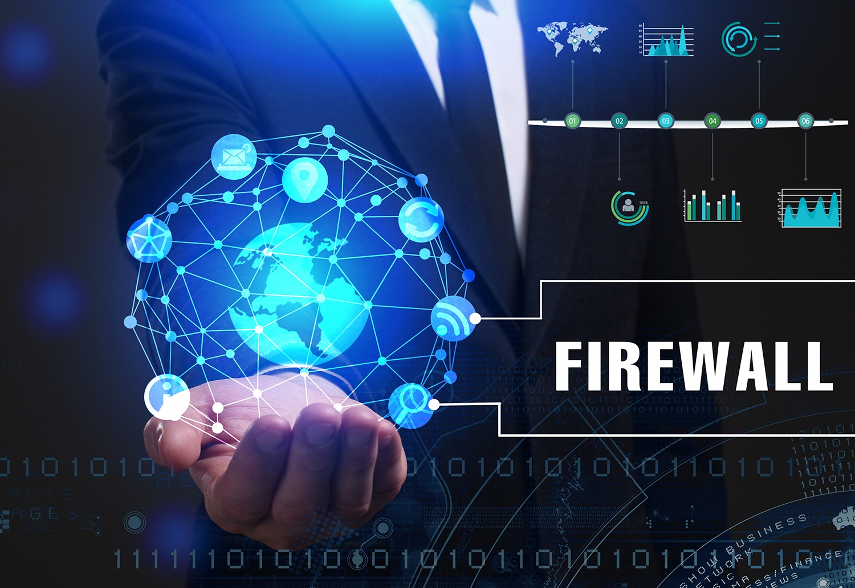

Slide 2
Table Of Content
What is a Firewall
Need Of Firewall
FIrewall Rules
General Types of Firewall
Hardware Firewall
Software Firewall
Types of Firewall
Packet Filtering Firewall
Stateful Inspection Firewall
Application Level Gateway Firewall
Circuit Level Gateway Firewall
Characteristics of Firewall
Functions of Firewall
Firewall Protection
Disadvantages of FIrewall
Conclusion

Slide 3
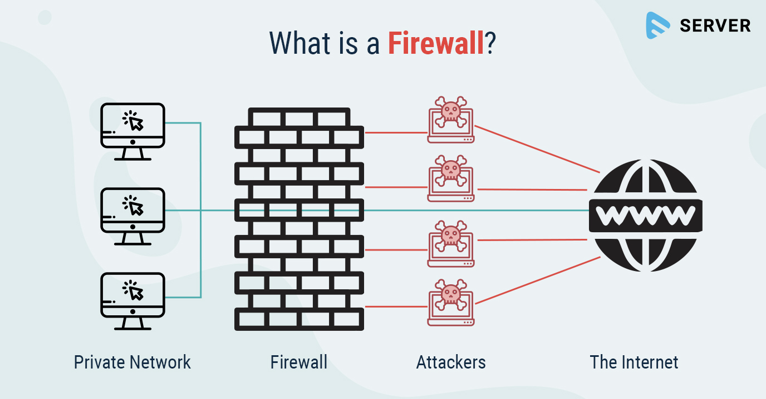

Slide 4
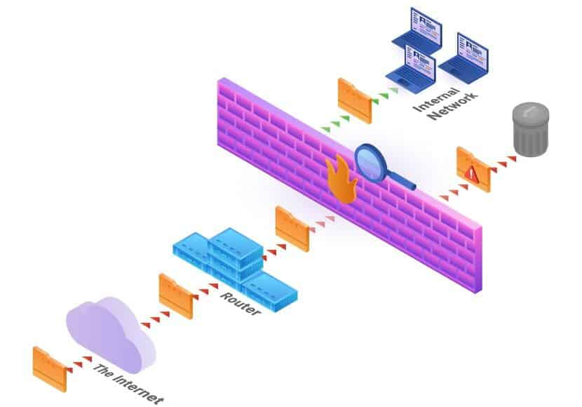
FIREWALL
A Firewall is a hardware or software designed to permit or deny network transmission based upon a set of rules and is frequently used to protect networks from unauthorized access while permitting legitimate communications to pass.

Slide 5
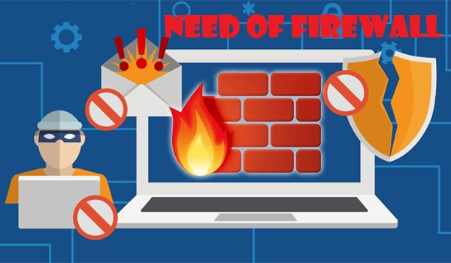

Slide 6
NEED OF FIREWALL
Information systems in corporations, government agencies, and other organizations have undergone a steady evolution. The following are notable developments:
• Centralized data processing system, with a central mainframe supporting a number of directly connected terminals
• Local area networks (LANs) interconnecting PCs and terminals to each other and the mainframe
• Premises network, consisting of a number of LANs, interconnecting PCs, servers, and perhaps a mainframe or two
• Enterprise-wide network, consisting of multiple, geographically distributed premises networks interconnected by a private wide area network (WAN)
• Internet connectivity, in which the various premises networks all hook into the Internet and may or may not also be connected by a private WAN

Slide 7


Slide 8
Rules Of Firewall
Allow : traffic that automatically flows because it has been
deemed.
Block: traffic that is blocked because it has been deemed
dangerous to computer.
Ask: ask the user whether or not the traffic is allowed to
pass through.

Slide 9
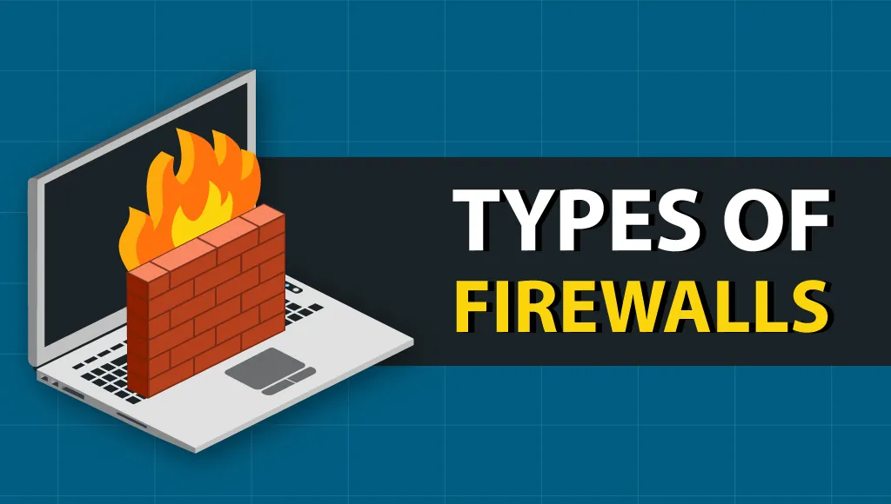

Slide 10
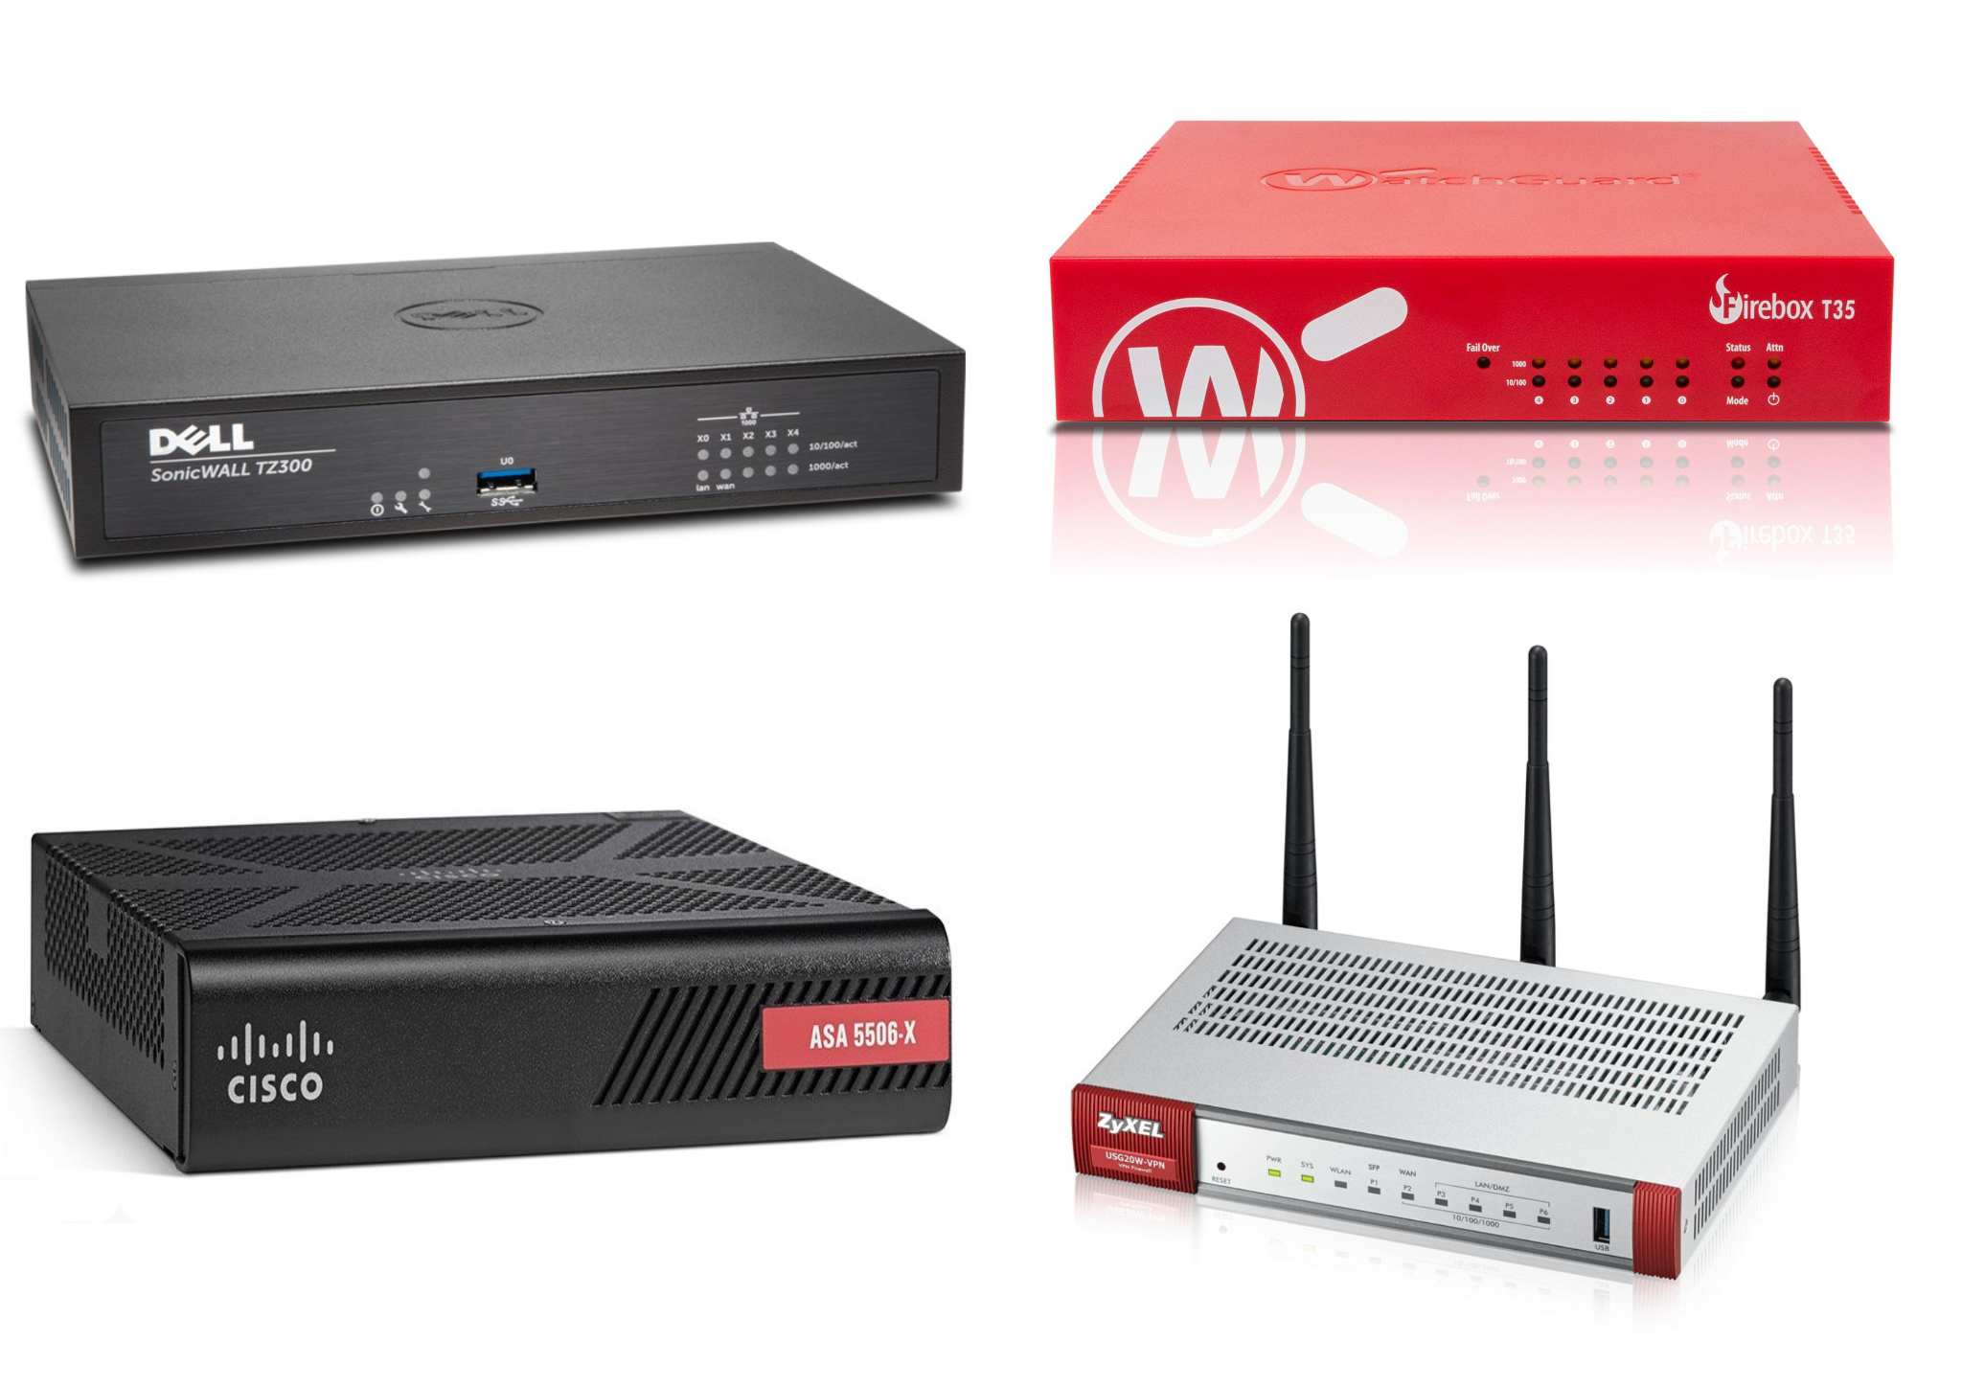
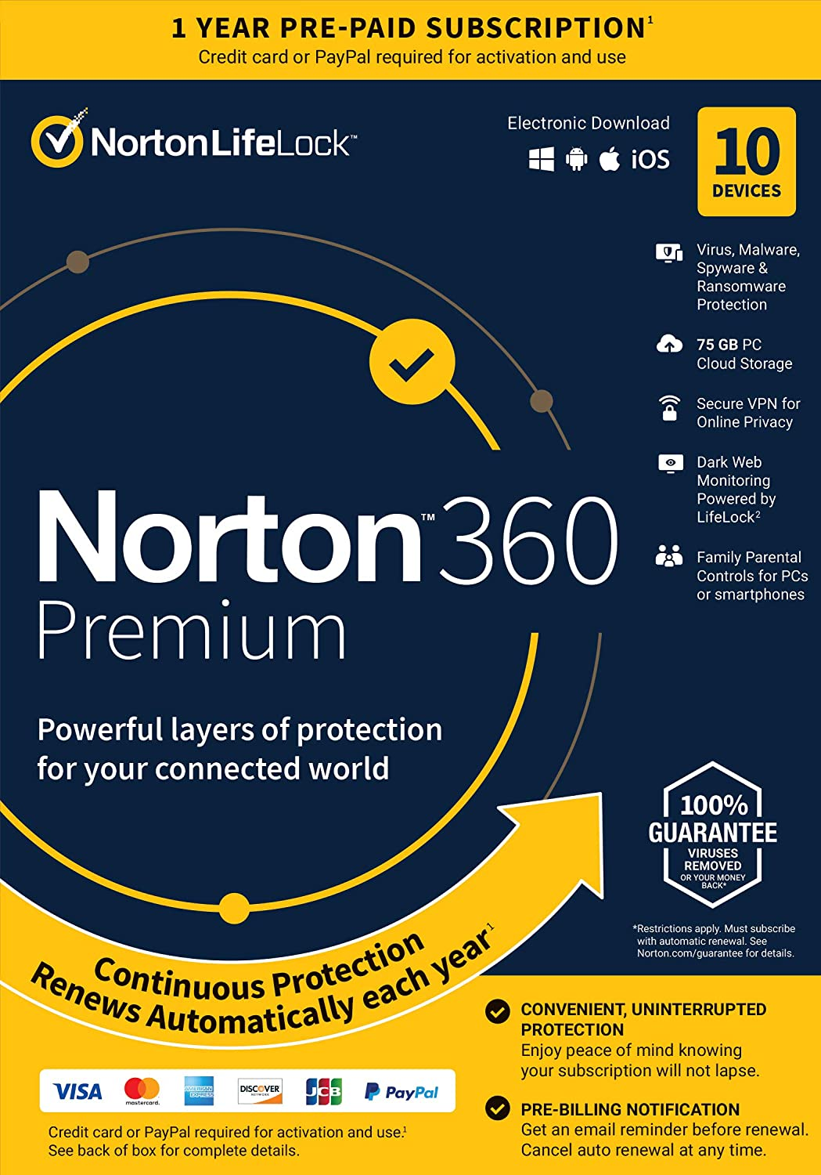
General Types of Firewall
Hardware Firewall
Software Firewall

Slide 11
Hardware Firewall
It is physical piece of equipment planed to perform firewall duties. A hardware firewall can be a computer or a dedicated piece of equipment which serve as a firewall. Hardware firewall are incorporated into the router that is situated between the computer and the internet gateway.

Slide 12
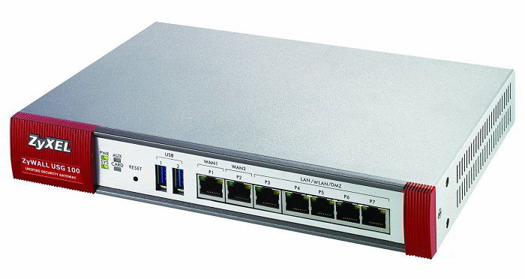

Slide 13
Software Firewall
Software firewall is a special type of computer software runs on a computer/server. It’s main purpose is to protect your computer/server from outside attempts to control or gain access and depending on your choice of software firewall. Software firewall can also be configured for checking any suspicious outgoing requests.

Slide 14
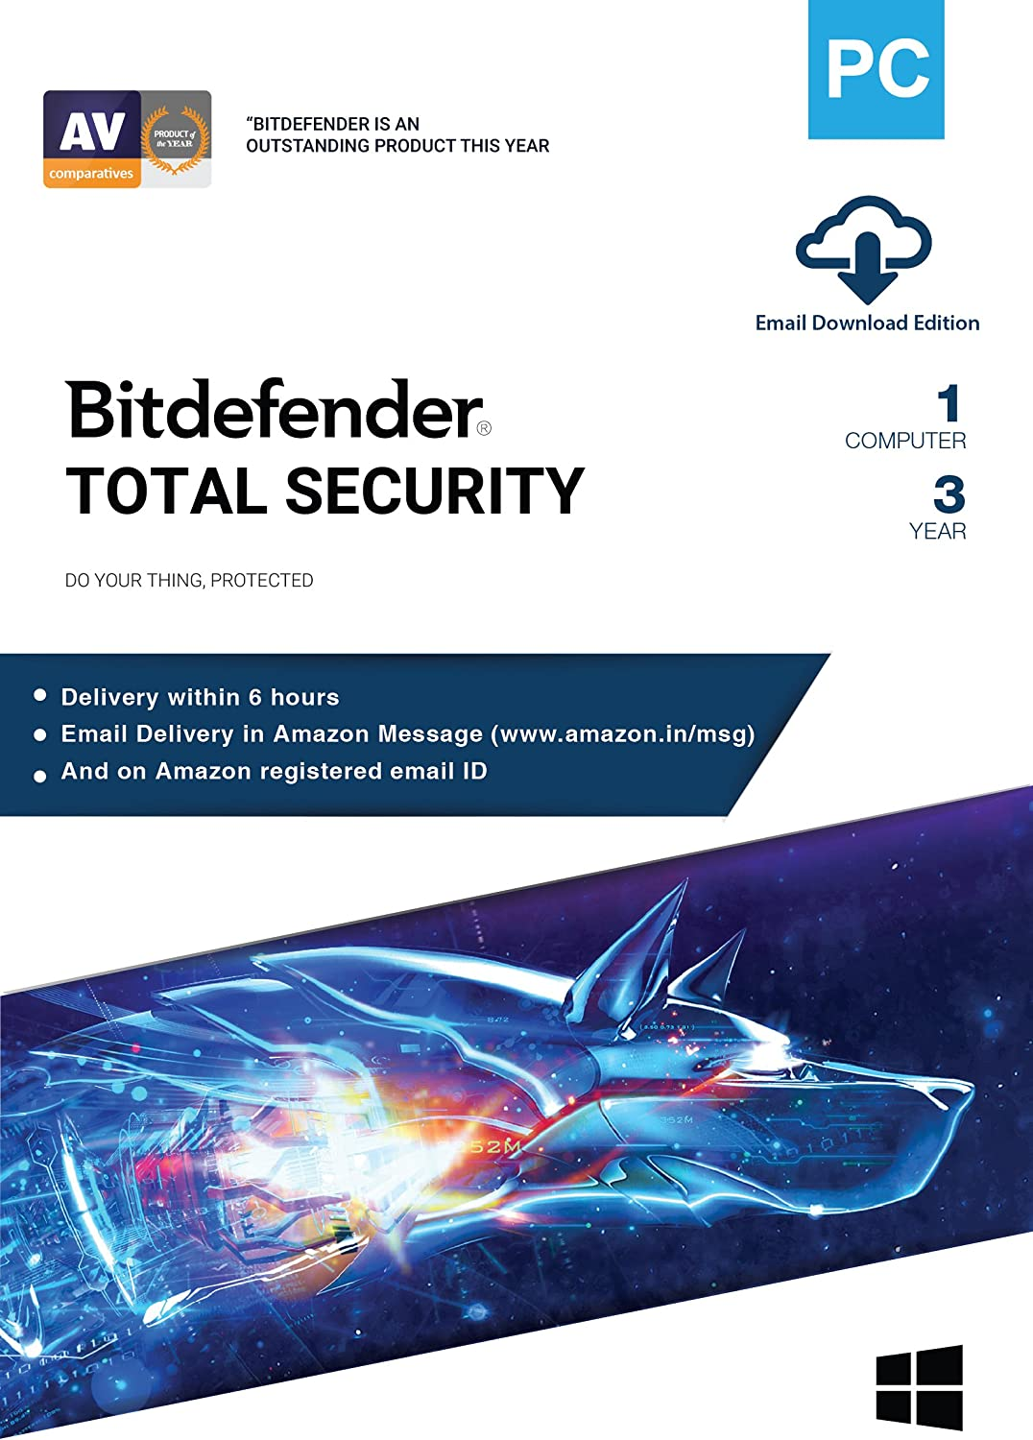

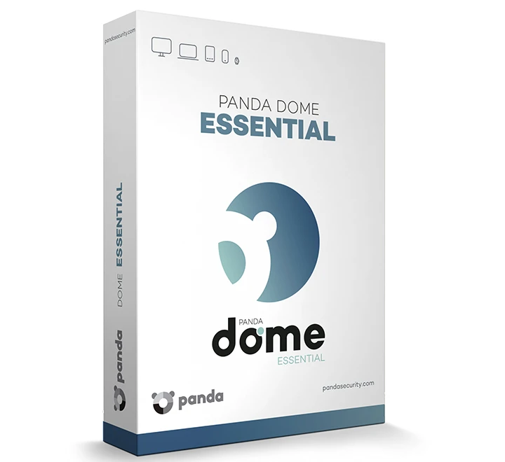
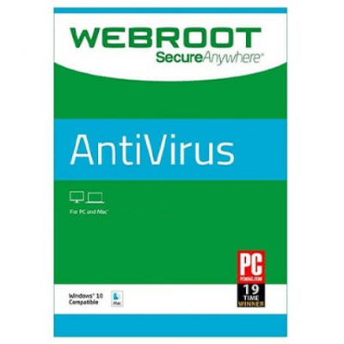
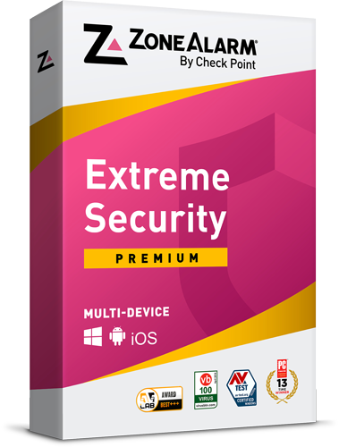
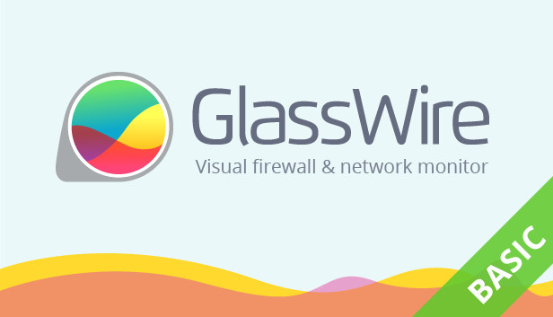

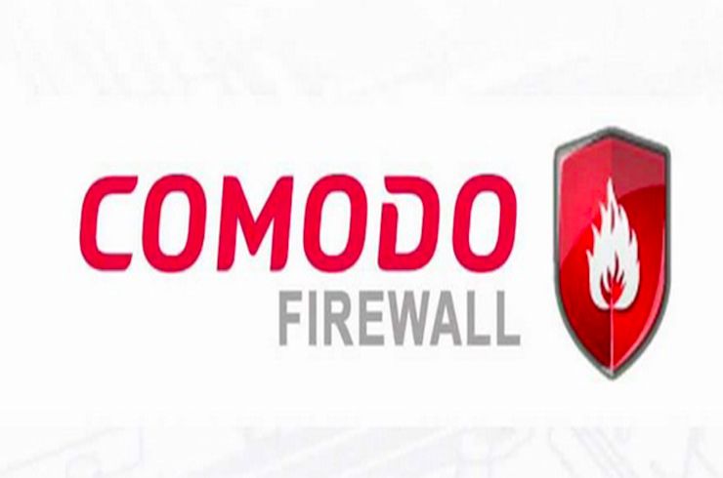

Slide 15
Type of Firewall
Packet Filtering Firewall
Stateful Inspection Firewalls
Application-Level Gateway
Circuit-Level Gateway

Slide 16
Packet Filtering Firewall
A packet filtering firewall applies a set of rules to each incoming and outgoing IP packet and then forwards or discards the packet. The firewall is typically configured to filter packets going in both directions (from and to the internal network).
Filtering rules are based on information contained in a network packet:
• Source IP address: The IP address of the system that originated the IP packet (e.g., 192.178.1.1).
• Destination IP address: The IP address of the system the IP packet is trying to reach (e.g., 192.168.1.2).
• Source and destination transport-level address: The transport-level (e.g., TCP or UDP) port number, which defines applications such as SNMP or TELNET .
• IP protocol field: Defines the transport protocol .
• Interface: For a firewall with three or more ports, which interface of the firewall the packet came from or which interface of the firewall the packet is destined for.

Slide 17
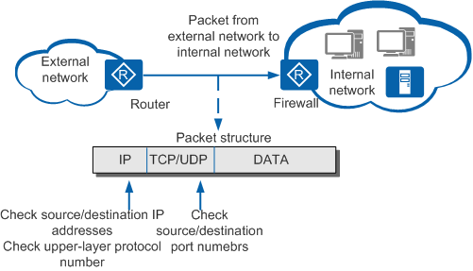

Slide 18
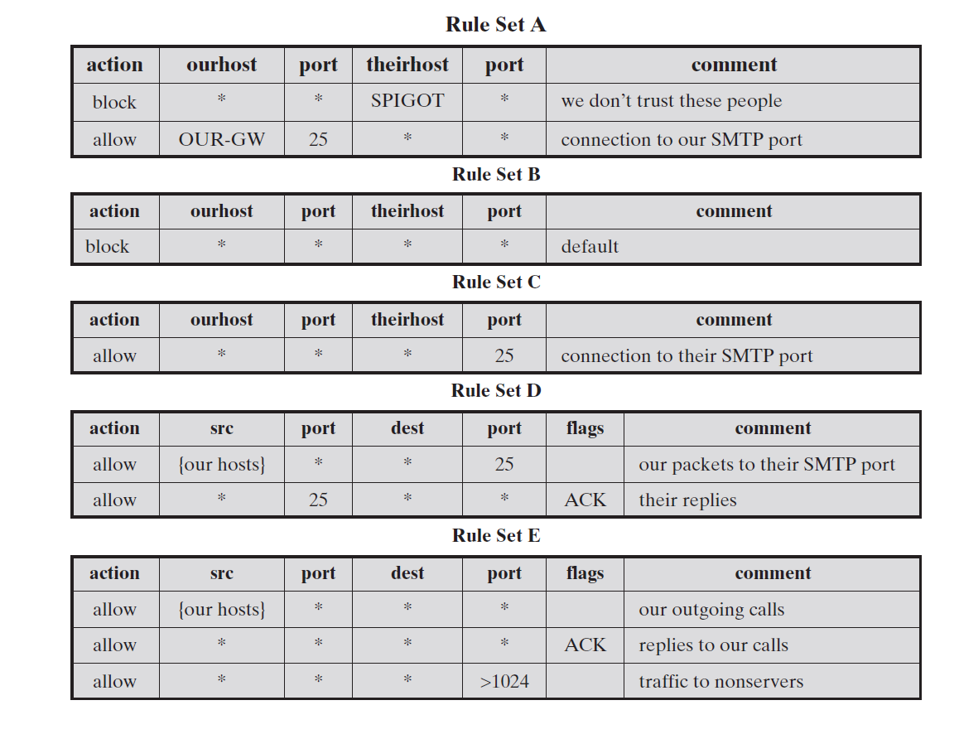

Slide 19
Stateful Inspection Firewalls
The stateful inspection firewall is an improvement of basic packet filtering. This type of firewall will examine each packet.It will then deny or permit access based not only on the examination of current packet but also on data derived on previous packets in the conversation.
This means that the firewall is aware of the context in which specific packets was sent.The name stateful packet inspection derives from the fact that in addition to examining the packet,the firewall examines the packet’s state in relationship to the entire IP conversation.This means the firewall can refer to the preceding packets as well as those packet’s content , source and destination.

Slide 20
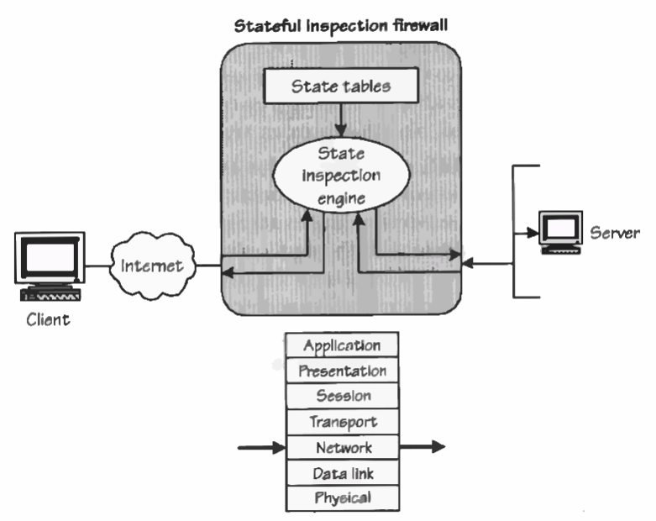

Slide 21
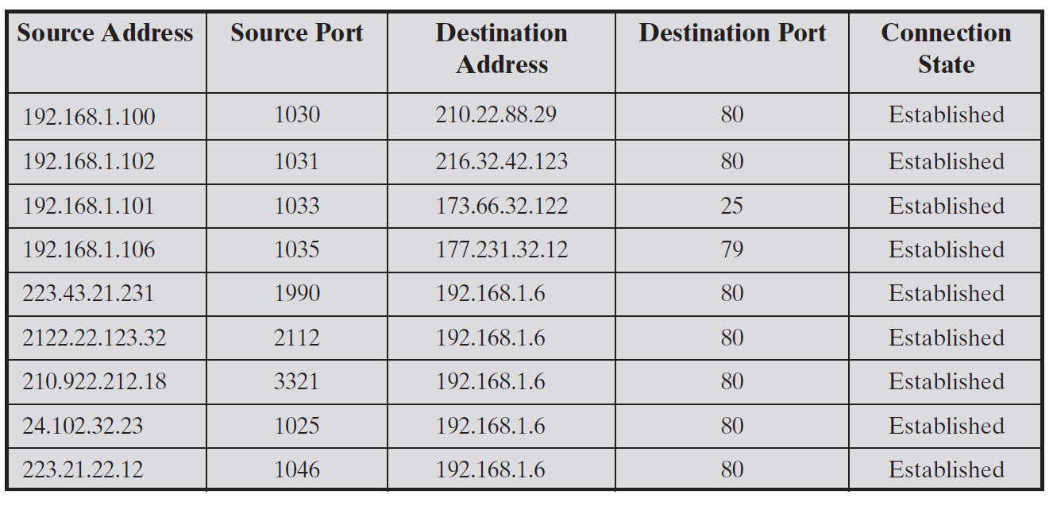

Slide 22
Application Level Gateway
An application-level gateway, also called an application proxy, acts as a relay of application-level traffic. The user contacts the gateway using a TCP/IP application, such as Telnet or FTP, and the gateway asks the user for the name of the remote host to be accessed. When the user responds and provides a valid user ID and authentication information, the gateway contacts the application on the remote host and relays TCP segments containing the application data between the two endpoints.

Slide 23
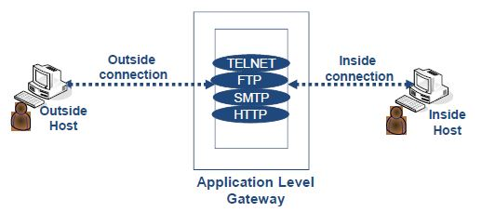

Slide 24
Circuit-Level Gateway
It can be a stand-alone system or it can be a specialized function performed by an application-level gateway for certain applications.
A circuit-level gateway does not permit an end-to-end TCP connection.
The gateway sets up two TCP connections, one between itself and a TCP user on an inner host and one between itself and a TCP user on an outside host. Once the two connections are established, the gateway typically relays TCP segments from one connection to the other without examining the contents. The security function consists of determining which connections will be allowed.

Slide 25
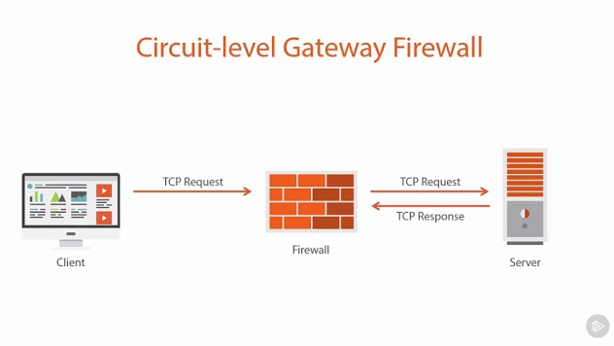

Slide 26
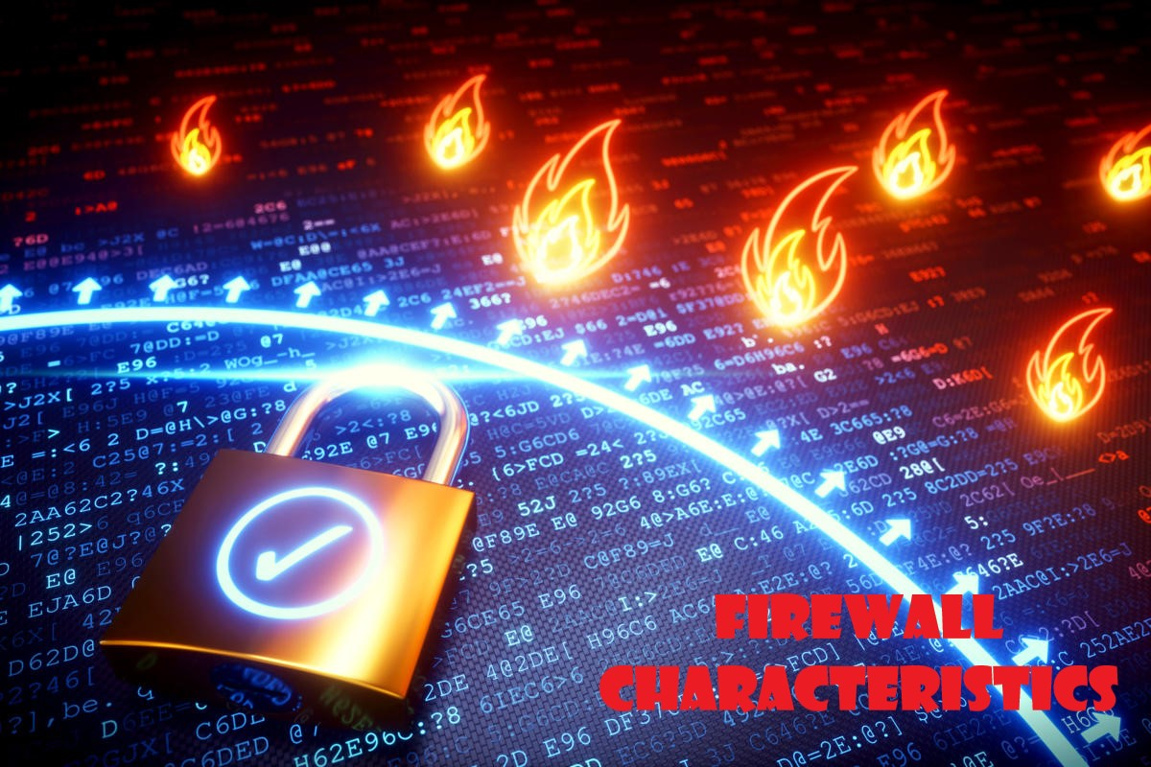

Slide 27
Characteristics Of A Firewall
• Service control: Determines the types of Internet services that can be accessed, inbound or outbound. The firewall may filter traffic on the basis of IP address, protocol, or port number; may provide proxy software that receives and interprets each service request before passing it on; or may host the server software itself, such as a Web or mail service.
• Direction control: Determines the direction in which particular service requests may be initiated and allowed to flow through the firewall.
• User control: Controls access to a service according to which user is attempting to access it. This feature is typically applied to users inside the firewall perimeter (local users). It may also be applied to incoming traffic from external users; the latter requires some form of secure authentication technology, such as is provided in IPsec.
• Behavior control: Controls how particular services are used. For example, the firewall may filter email to eliminate spam, or it may enable external access to only a portion of the information on a local Web server.

Slide 28
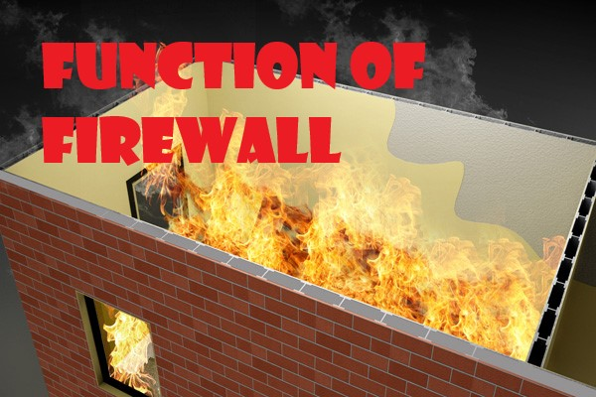

Slide 29
Function Of Firewall
1. A firewall defines a single choke point that keeps unauthorized users out of the protected network, prohibits potentially vulnerable services from entering or leaving the network, and provides protection from various kinds of IP spoofing and routing attacks.The use of a single choke point simplifies security management because security capabilities are consolidated on a single system or set of systems.
2. A firewall provides a location for monitoring security-related events. Audits and alarms can be implemented on the firewall system.
3. A firewall is a convenient platform for several Internet functions that are not security related. These include a network address translator, which maps local addresses to Internet addresses, and a network management function that audits or logs Internet usage.
4. A firewall can serve as the platform for IPsec , the firewall can be used to implement virtual private networks.

Slide 30
Firewall Protection
Remote Login
SMTP Session Hijacking
Operating System Bugs
Spam
Email Bombs
Source Routing

Slide 31
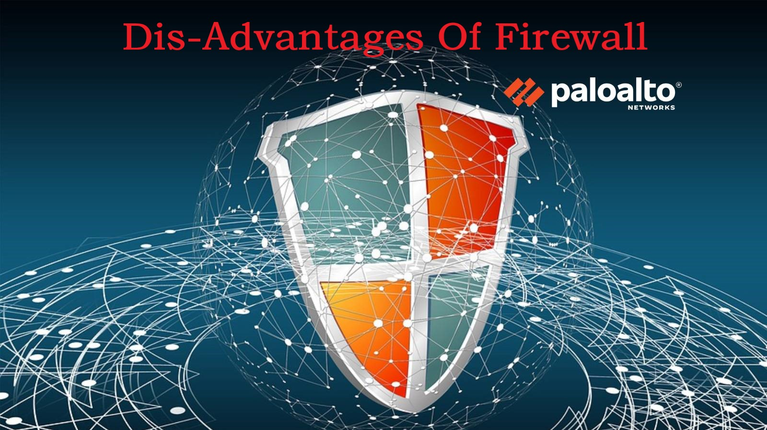

Slide 32
Disadvantages Of Firewall
The main disadvantage of a firewall is that it cannot protect the network from attacks from the inside.
They often cannot protect against an insider attack.
Firewalls cannot protect a network or pc from viruses, Trojans, worms and spyware which spread through flash drives, portable hard disk and floppy etc.
They may restrict authorized users from accessing valuable services.
They do not protect against backdoor attacks.
They cannot protect the network if someone uses a broadband modem to access the internet.

Slide 33


Slide 34
Conclusion
One of the best thing for a firewall from security standpoint is that it stops anyone on outside from logging onto a computer in your Private Network.
While this is a big deal for business most home networks will probably not be threaten in this manner. Still putting a firewall in place provides a peace of mind.

Slide 35


